Slide 1
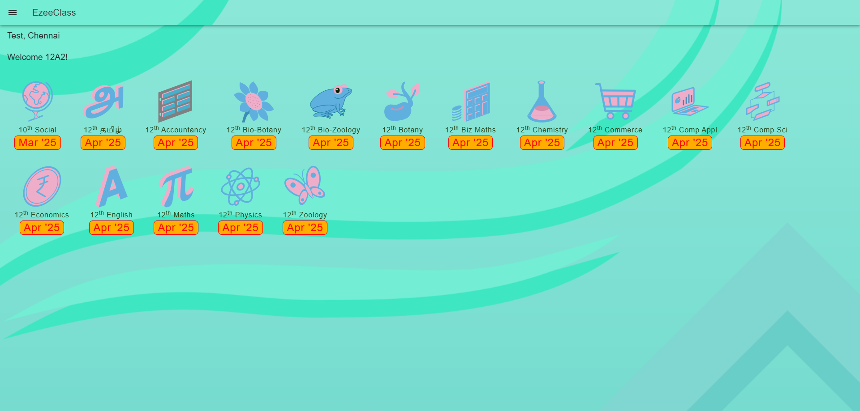

Slide 2

















Social (10)
Dec ‘25
Tamil (10)
Aug ‘24
Account (11)
Jan ‘25
Bio-Botany (12)
Nov ‘24
Bio-Zoology (12)
Nov ‘24
Botany (12)
Nov ‘24
Biz Maths (12)
Jul ‘24
Chemistry (12)
Feb ‘25
Commerce (11)
Sep ‘24
Comp Appl (12)
Nov ‘24
Comp Sci (11)
Jan ‘25
Economics (12)
Mar ‘24
English (10)
Aug ‘24
Maths (10)
Apr ‘25
Physics (12)
Jan ‘25
Zoology (12)
Nov ‘24
Science (10)
Jan ‘25
Science (9)
Jan ‘25

Slide 3

Social (10)
Dec ‘25
Tamil (10)
Aug ‘24
Account (11)
Jan ‘25
Bio-Botany (12)
Nov ‘24
Bio-Zoology (12)
Nov ‘24
Botany (12)
Nov ‘24
Biz Maths (12)
Jul ‘24
Chemistry (12)
Feb ‘25
Commerce (11)
Sep ‘24
Comp Appl (12)
Nov ‘24
Comp Sci (11)
Jan ‘25
Economics (12)
Mar ‘24
English (10)
Aug ‘24
Maths (10)
Apr ‘25
Physics (12)
Jan ‘25
Zoology (12)
Nov ‘24
Science (10)
Jan ‘25
Science (9)
Jan ‘25

Slide 4
Social (10)
Dec ‘25
Tamil (10)
Aug ‘24
Account (11)
Jan ‘25
Bio-Botany (12)
Nov ‘24
Bio-Zoology (12)
Nov ‘24
Botany (12)
Nov ‘24
Biz Maths (12)
Jul ‘24
Chemistry (12)
Feb ‘25
Commerce (11)
Sep ‘24
Comp Appl (12)
Nov ‘24
Comp Sci (11)
Jan ‘25
Economics (12)
Mar ‘24
English (10)
Aug ‘24
Maths (10)
Apr ‘25
Physics (12)
Jan ‘25
Zoology (12)
Nov ‘24
Science (10)
Jan ‘25
Science (9)
Jan ‘25

Slide 5
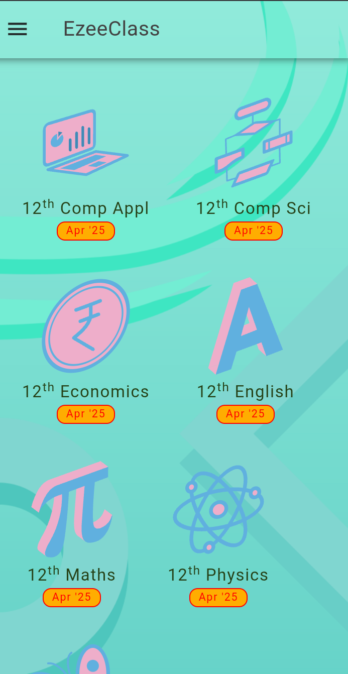

Slide 6

Comp Appl (12)
Nov ‘24
Comp Sci (11)
Nov ‘24
Economics(12)
Nov ‘24
English (10)
Nov ‘24
Maths(10)
Nov ‘24
Physics(12)
Nov ‘24

Slide 7
Comp Appl (12)
Nov ‘24
Comp Sci (11)
Nov ‘24
Economics(12)
Nov ‘24
English (10)
Nov ‘24
Maths(10)
Nov ‘24
Physics(12)
Nov ‘24

Slide 8
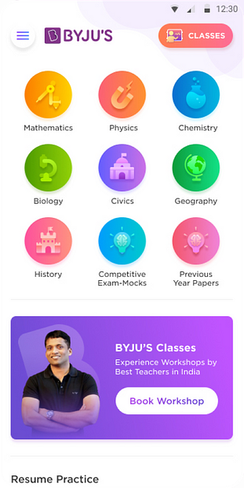
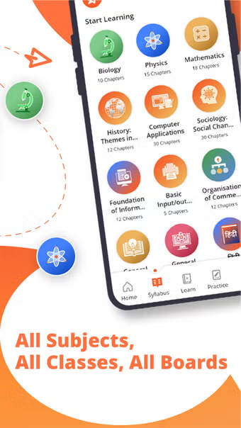

Slide 9
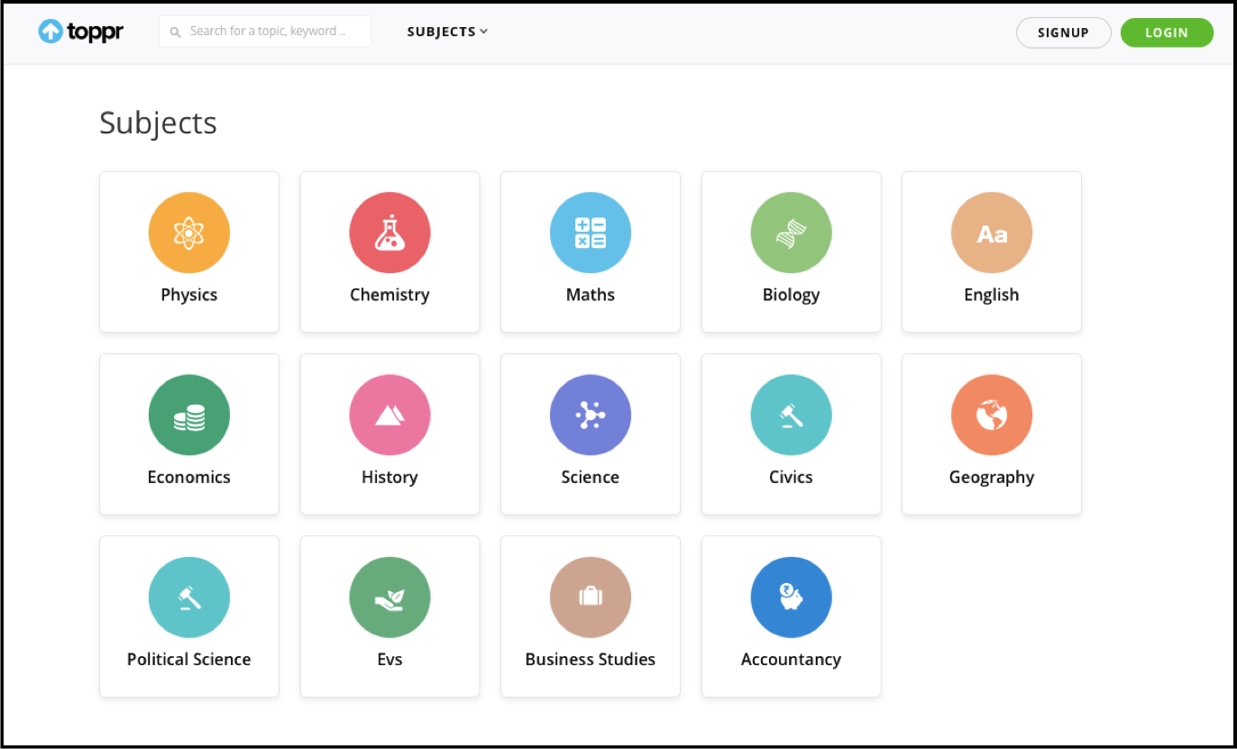

Slide 10


EzeeClass
Test, Chennai
Welcome 12A2!
Social (10)
Dec ‘25
Tamil (10)
Aug ‘24
Account (11)
Jan ‘25
Bio-Botany (12)
Nov ‘24
Bio-Zoology (12)
Nov ‘24
Botany (12)
Nov ‘24
Biz Maths (12)
Jul ‘24
Chemistry (12)
Feb ‘25
Commerce (11)
Sep ‘24
Comp Appl (12)
Nov ‘24
Comp Sci (11)
Jan ‘25
Economics (12)
Mar ‘24
English (10)
Aug ‘24
Maths (10)
Apr ‘25
Physics (12)
Jan ‘25
Zoology (12)
Nov ‘24
Science (10)
Jan ‘25
Science (9)
Jan ‘25

Slide 11

Accountancy

Slide 12

Bio-Botany / Botany

Slide 13



Bio-Zoology / Zoology

Slide 14


Business Maths

Slide 15


Chemistry

Slide 16

Commerce

Slide 17

Computer Applications

Slide 18

Computer Science

Slide 19

Economics

Slide 20

English

Slide 21

Maths

Slide 22

Physics

Slide 23
Social (10)
Dec ‘25
Tamil (10)
Aug ‘24
Account (11)
Jan ‘25
Bio-Botany (12)
Nov ‘24
Bio-Zoology (12)
Nov ‘24
Botany (12)
Nov ‘24
Biz Maths (12)
Jul ‘24
Chemistry (12)
Feb ‘25
Commerce (11)
Sep ‘24
Comp Appl (12)
Nov ‘24
Comp Sci (11)
Jan ‘25
Economics (12)
Mar ‘24
English (10)
Aug ‘24
Maths (10)
Apr ‘25
Physics (12)
Jan ‘25
Zoology (12)
Nov ‘24
Science (10)
Jan ‘25
Science (9)
Jan ‘25

Slide 24

Science

Slide 25


Social Science

Slide 26





Tamil

Slide 27


Career Compass

